Slide 1



DIGITAL EGYPT PIONEEER INITIATIVE (DEPI 2024)
EGYPT UNIVERSITY OF INFORMATICS eui
Data Analytics Track
Final Project
Under supervision of
Dr. Anas Ismail
Presented by
Mohamad Ali Abdelghani
Group:C2 ID: 1120147595

Slide 2
Project Overview
This repository presents an in-depth analysis of airline and airport operations for US flights for a year.
The project encompasses a full lifecycle of data handling from extraction through visualization, focusing on over 500,000 commercial airline flights records.
Tools:
Excel
Power BI
Python
NumPy, Pandas, Matplotlib, Seaborn

Slide 3
data inspection
Datasets:
Flights
Airlines
Airports
A_Codes
N_Codes
Data Dictionary
Data Source type : CSV and Excel files
The main dataset Flights contains 16 columns. Total Flights: 581746
Cancelled Flights: 10988
On-time Flights: 570758
Cancellation Rate: 1.89%
On-time Rate: 98.11%
Delayed Rate: 24.20%
Missing and inaccurate Data:
TAIL_NUMBER: 1,428 missing
SCHEDULED_TIME: 4 missing
CANCELLATION_REASON: 570,758 missing
Various delay columns (e.g., AIR_SYSTEM_DELAY, SECURITY_DELAY, etc.) have 445,682 missing values each.
ORIGIN_AIRPORT = DESTINATION_AIRPORT
LATITUDE and LONGITUDE missing

Slide 4
Data Cleaning
Missing values have been handled according to best practices.
1. For categorical data like TAIL_NUMBER, using a placeholder like 'Unknown' preserves the information that the data was missing.
2. For numerical data like SCHEDULED_TIME, using the median is often preferred over the mean as it's less sensitive to outliers.
3. For CANCELLATION_REASON, 'Not Canceled' was used as it's a logical assumption for flights without a cancellation reason.
4. For delay columns, zero was used as it's a reasonable assumption that no delay was recorded for these instances.
5. For Origin = Destination , this data will be deleted and excluded from analysis.
6. For Longitude and Latitude, using a placeholder like 'Unknown'

Slide 5
Scope
The domestic flights within USA within one year.
Flight Status Analysis: Examining the proportion of flights that were delayed, canceled, or arrived on time.
Delay Causes: Analyzing various causes of delays : Airline. Weather, Security, Aircraft delays.
Airline Performance Comparison: Comparing the performance of different airlines based on metrics such as on-time arrival rates and average delays.
Geographic Analysis: Studying the impact of different origin and destination airports on flight delays and cancellations.
Monthly and Seasonal Trends: Analyzing trends over different months and seasons to identify patterns in flight performance.
Distance Impact: Investigating how flight distance correlates with delays and cancellations.

Slide 6
Limitations
International Flights: The analysis will focus solely on domestic flights within the USA, excluding any international routes.
Non-Flight Data: Data unrelated to flight performance, such as passenger demographics or ticket pricing, will not be included.
Individual Flight Details: The project will not delve into specific flight incidents or individual passenger experiences.
Real-time Data Analysis: The analysis will be based on historical data and will not involve real-time flight tracking or forecast modeling.
Time Boundary: The analysis will focus on flight data from only one year, providing insights within this specific time frame.

Slide 7
Significance
The analysis of USA flights data has the potential to drive significant improvements in the aviation industry, benefiting airlines, passengers, and the economy as a whole.
Improving Airline Operations: : By identifying patterns and causes of delays, airlines can implement strategies to improve on-time performance, enhance customer satisfaction, and optimize operational efficiency.
Consumer Awareness: Passengers can make informed choices regarding airlines and routes based on the analysis of performance metrics, which can lead to better travel experiences.
Policy Making: Understanding flight delays and cancellations can help quantify their economic impact on the travel industry, which is vital for planning and investment.
Economic Impact: Understanding flight delays and cancellations can help quantify their economic impact on the travel industry, which is vital for planning and investment.
Resource Allocation: Airports and airlines can better allocate resources (such as staff and aircraft) based on seasonal demand and performance data, leading to cost savings and improved service levels.

Slide 8


Navigating the Skies
Insights from US Flights Dataset

Slide 9
Introduction
Imagine a world where every flight tells a story.
Today, we will explore the intricate web of flight routes, delays, and the geographical distribution of airports that connect all states of America.
Objective
Our goal is to uncover patterns in flight routes, analyze delays, and understand the geographical landscape of air travel.

Slide 10
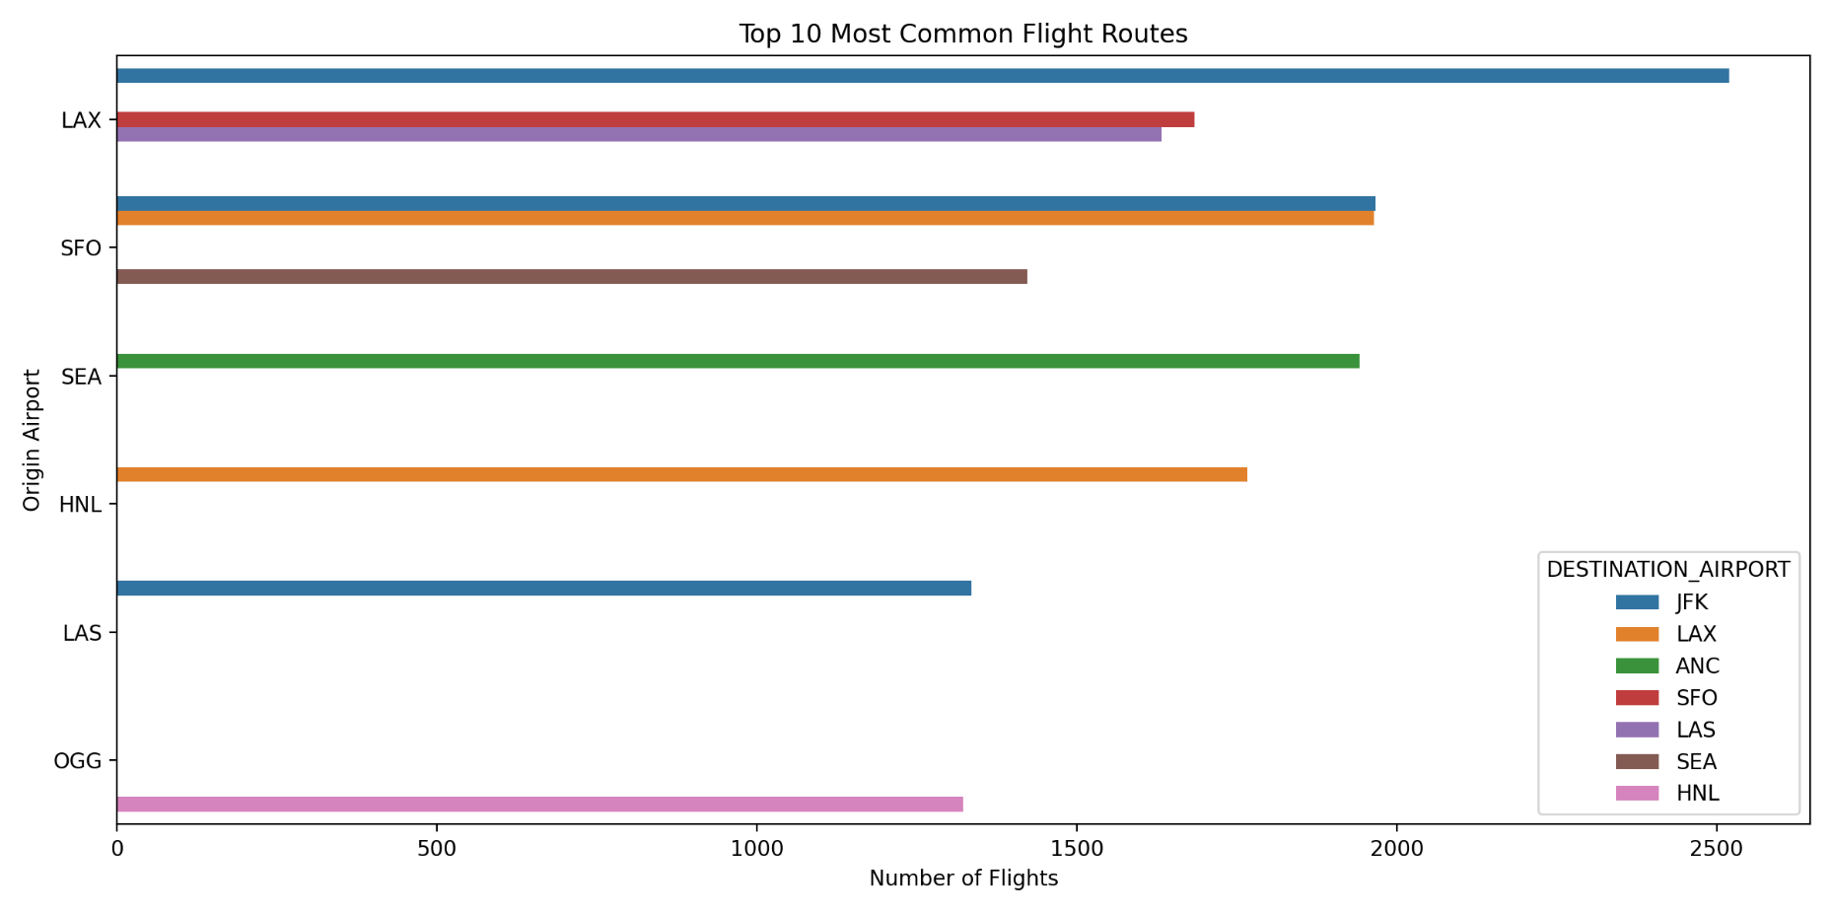
The Most Common Flight Routes
Let’s start our journey by examining the most traveled routes.
The flight from Los Angeles (LAX) to New York (JFK) stands out as the most popular, with over 2,500 flights annually
This route symbolizes the connection between the bustling West Coast and the vibrant East Coast, serving as a lifeline for business and leisure travelers alike
The most frequent route is from Los Angeles (LAX) to New York (JFK), followed by San Francisco (SFO) to New York (JFK), and San Francisco (SFO) to Los Angeles (LAX).

Slide 11
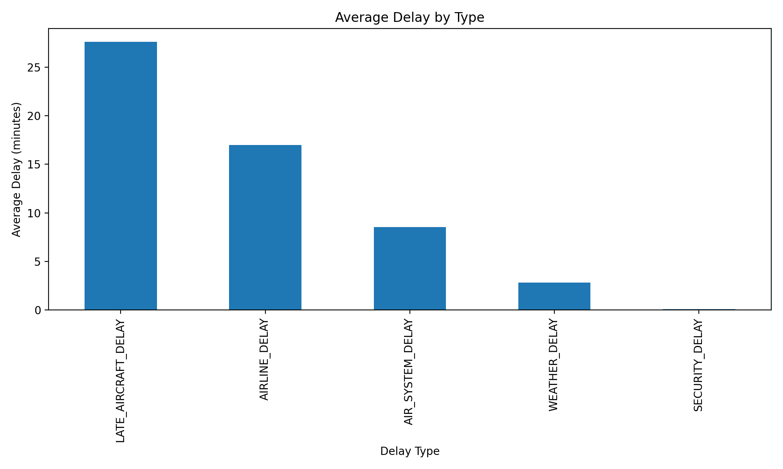
Understanding Delays
However, not all journeys are smooth. Our analysis reveals that late aircraft delays are the most significant, averaging over 27 minutes.
This delay can ripple through the entire travel experience, affecting connections and passenger satisfaction.
Understanding these delays is crucial for airlines to improve their operations and enhance customer experience.
Late aircraft delays are the most significant, followed by airline delays. Security delays are the least common.

Slide 12
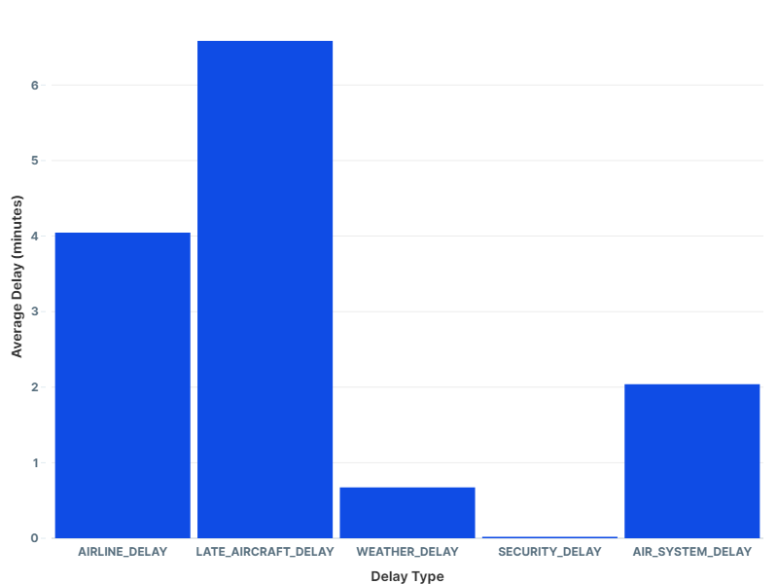
Delay Analysis
Average delay durations were examined for various types: airline, late aircraft, weather, security, and air system delays.
Insight:
Understanding which delays are most common can guide operational improvements.

Slide 13
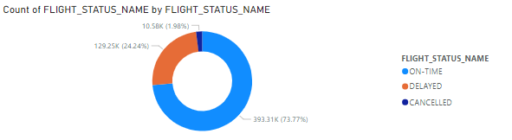
Overall Flight Performance
Key Metrics:
On-Time Performance: Approximately 73.77% of flights were on time.
Cancellation Rate: Around 1.89%.
Delay Rate: Around 24.24%
Insight:
These metrics indicate a need for improvement in operational efficiency.

Slide 14
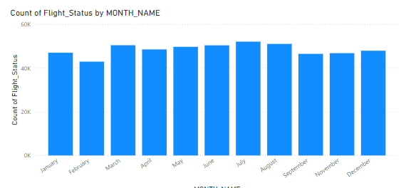
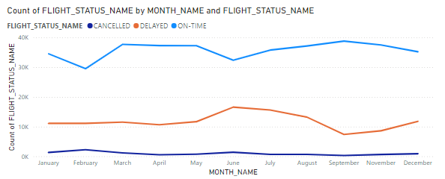
Seasonal Variations in Flight Demand
Total flights and on-time performance were analyzed across different months.
Insight:
Identifying peak travel months can help airlines optimize scheduling and resource allocation.

Slide 15
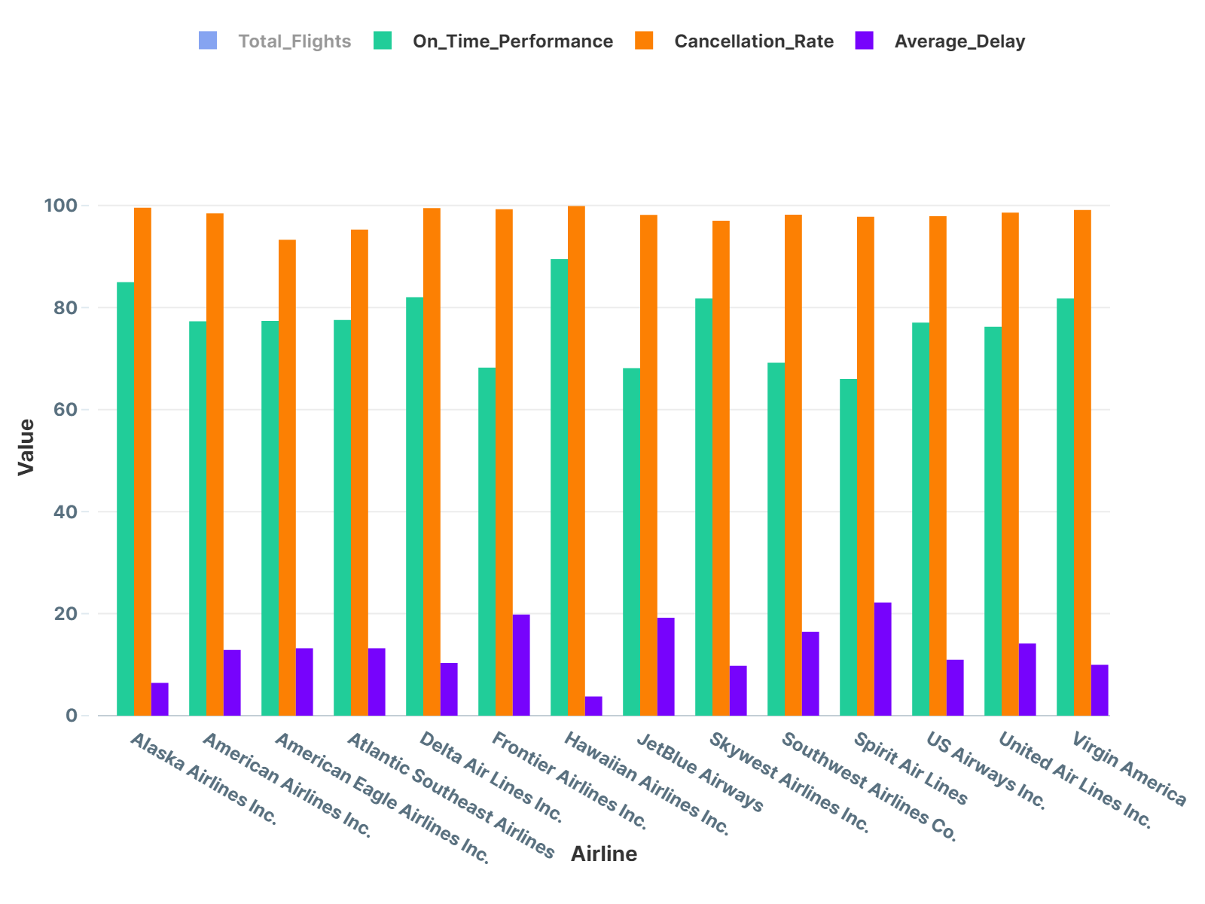
Airline Performance Comparison
Comparison of on-time performance, cancellation rates, and average delays across airlines.
Insight:
Identifying high-performing airlines can provide benchmarks for others to improve their services.

Slide 16
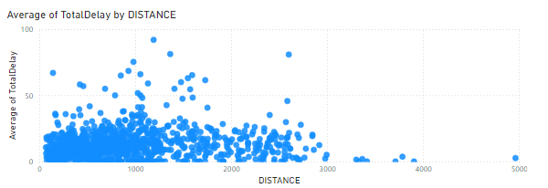
Flight Distance and Delay Patterns
Relationship between flight distance and total delays was explored.
Insight:
Longer flights may exhibit different delay characteristics, suggesting a need for tailored strategies.

Slide 17
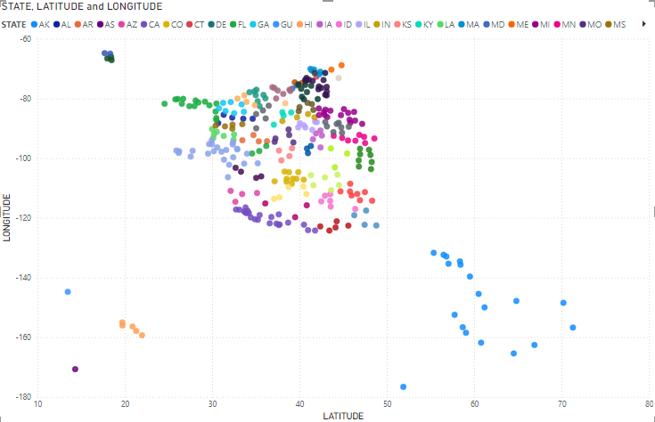
Geographical Distribution of Airports
Now, let’s take a bird’s-eye view of the geographical distribution of airports.
Each dot on this map represents an airport, showcasing the vast network that supports air travel.
Insights:
Airports with high traffic may require infrastructure improvements to handle demand effectively.
The concentration of airports across different regions.

Slide 18
impact of origin/destination on delays/cancellations
Average Delay by Origin Airport:
Certain airports may show significantly higher average delays compared to others. This can indicate operational inefficiencies, congestion, or other issues at those airports.
By analyzing these metrics, airlines can identify problematic routes and make data-driven decisions to improve their operations. Additionally, passengers can use this information when planning their travels, opting for airports with better on-time performance and lower cancellation rates.
Average Delay by Destination Airport:
Some destination airports might have higher average delays. This could reflect the time taken for planes to reach their gates after landing or issues in air traffic control at those locations.
Cancellation Rates by Origin Airport:
Specific origin airports may have higher cancellation rates. This information is crucial for travelers choosing their departure points and for airlines to manage their operations effectively.
Cancellation Rates by Destination Airport:
Certain destination airports may also show higher cancellation rates. This can affect travel planning and give insights into the reliability of various routes.

Slide 19
Busiest Airports
The busiest Origin/ Destination airports in the network
ORIGIN AIRPORT | Count
ATL | 62172
ORD | 35579
DFW | 33455
LAX | 29588
SFO | 24159
DEN | 23221
LAS | 17659
SLC | 17380
PHX | 16869
CLT | 16701
DESTINATION AIRPORT | Count
LAX | 23424
LAS | 17474
BOS | 16788
JFK | 15501
ORD | 14139
PHX | 13873
SFO | 13371
DEN | 13262
ATL | 11465
EWR | 10688
As we delve deeper, we find that Atlanta (ATL) emerges as the busiest origin airport, while Los Angeles (LAX) is the most frequented destination.
This dynamic reflects the flow of passengers seeking opportunities, whether for business, family, or adventure
1
2
3
4
5
6
7
8
9
10

Slide 20
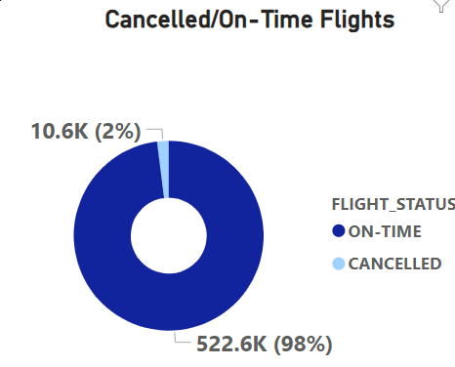
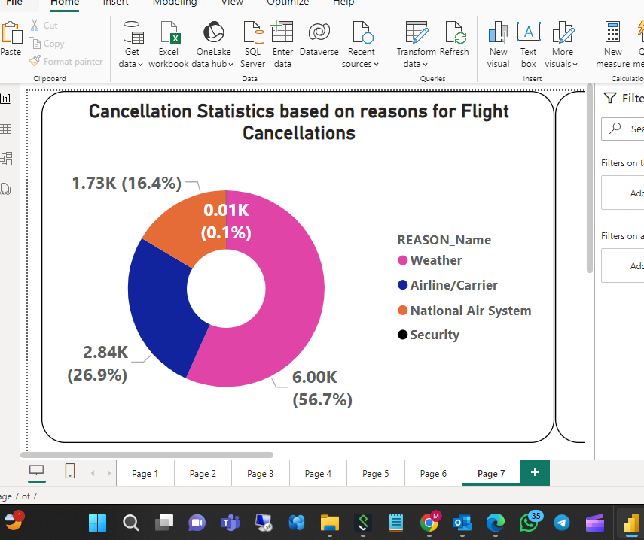
Key Insights:
A comprehensive view of flight cancellations, their reasons, and how they affect different airlines
The overall cancellation rate is relatively low at 1.89% of all flights.
Weather is the most common reason for cancellations, accounting for 6,195 out of 10,988 cancellations.
Airline/Carrier issues are the second most common reason, followed by National Air System problems.
Security-related cancellations are very rare, with only 7 occurrences.
Among airlines, Southwest Airlines (WN) has the highest number of cancellations, followed by Delta Air (DL) and American Airlines (AA).

Slide 21
Actionable Recommendations
Improve On-Time Performance:
Collaborate with airlines to address root causes of delays.
Address Cancellation Rates:
Investigate reasons for cancellations and develop contingency plans.
Optimize Scheduling:
Use seasonal trends to adjust flight schedules and staffing.
Enhance Customer Communication:
Provide timely updates during delays to improve passenger experience.

Slide 22
Conclusion
In conclusion, our exploration of flight data reveals not just numbers, but stories of connection, delay, and geography.
By understanding these patterns, airlines can enhance their services, and travelers can make informed decisions.
Together, we can navigate the skies more effectively
Call to Action
Let’s Implement recommendations and continuously monitor performance metrics to adapt to changing trends.
Let’s continue to explore and innovate in the world of air travel, ensuring that every journey is a positive experience.

Slide 23
Thank you for your Attention
Presented by
Mohamad Ali Abdelghani
Group:C2 ID: 1120147595

